Slide 1
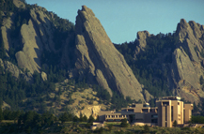
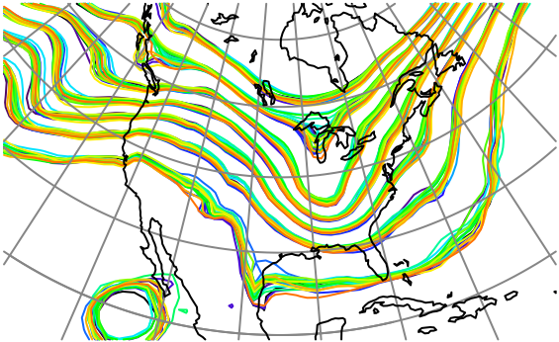

Ensemble Data Assimilation for Observations with Spatially and Temporally Correlated Errors
Jeffrey Anderson, NCAR Data Assimilation Research Section

Slide 2
Outline
Dealing with correlated observation error in ensemble filters.
Idealized correlated error.
Difference observations.
Explictly modeling instrument error.
Comparing the two methods.
Conclusions and recommendations.

Slide 3
Most Observations Have Correlated Obs. Errors
Examples:
Satellite radiances: instrument bias and aging.
In situ soil moisture: instrument plus siting representativeness.
Rainfall: gauge deficiencies plus siting.

Slide 4
Observation Error Time Series
Example: Correlated Error AR1 with Variance 1.
Single Step Cov 0.999. Fixed for all cases.

Slide 5
Observation Error Time Series
Example: Correlated Error AR1 with Variance 1.
Single Step Cov 0.999. Fixed for all cases.
Vary uncorrelated error variance, 0.01

Slide 6
Observation Error Time Series
Example: Correlated Error AR1 with Variance 1.
Single Step Cov 0.999. Fixed for all cases.
Vary uncorrelated error variance, 0.1

Slide 7
Observation Error Time Series
Example: Correlated Error AR1 with Variance 1.
Single Step Cov 0.999. Fixed for all cases.
Vary uncorrelated error variance, 1.0

Slide 8
Observation Error Time Series
Example: Correlated Error AR1 with Variance 1.
Single Step Cov 0.999. Fixed for all cases.
Vary uncorrelated error variance, 10.0

Slide 9
Possible approaches to dealing with correlated obs error
Ignore it (common),
Add parameters to forward operator, estimate them,
Model it explicitly (various ways),
Time difference observations.

Slide 10
1D Linear Exponential Growth Model
True trajectory is always 0.
Evolution is
Perturbations grow exponentially in time.

Slide 11
Outline
Dealing with correlated observation error in ensemble filters.
Idealized correlated error.
Difference observations.
Explictly modeling instrument error.
Comparing the two methods.
Conclusions and recommendations.

Slide 12
Assimilating Correlated Observations
Obs1
Obs2
Obs3
Obs4
Obs5
Obs6

Slide 13
1D Exponential Growth Model Results
Exact Smoother Result. Can’t do better than this.

Slide 14
1D Exponential Growth Model Results
EAKF Poor Unless Uncorrelated Error Dominates
RMSE
Spread

Slide 15
Two Types of Difference Observations
Obs1
Obs2
Obs3
Obs4
Obs5
Obs6

Slide 16
Unlinked Difference Observations
Unlinked
Diff 1
Unlinked
Diff 3
Unlinked
Diff 5
Obs1
Obs2
Obs3
Obs4
Obs5
Obs6

Slide 17
1D Exponential Growth Model Results
Exact Unlinked Difference Obs Much worse.
Exact
Unlinked

Slide 18
Uninked Difference Observations
Unlinked
Diff 1
Unlinked
Diff 3
Unlinked
Diff 5
Obs1
Obs2
Obs3
Obs4
Obs5
Obs6

Slide 19
Uninked Difference Observations
Unlinked
Diff 1
Unlinked
Diff 3
Unlinked
Diff 5
Obs1
Obs2
Obs3
Obs4
Obs5
Obs6

Slide 20
1D Exponential Growth Model Results
EAKF is nearly exact for Unlinked Difference Obs.
RMSE and
Spread

Slide 21
Linked Difference Observations
Linked
Diff 1
Linked
Diff 3
Linked
Diff 5
Obs1
Obs2
Obs3
Obs4
Obs5
Obs6
Linked
Diff 2
Linked
Diff 4

Slide 22
1D Exponential Growth Model Results
Exact linked Difference Obs Nearly Identical to Analytic.
Linked

Slide 23
Linked Difference Observations
Linked
Diff 1
Linked
Diff 3
Linked
Diff 5
Obs1
Obs2
Obs3
Obs4
Obs5
Obs6
Linked
Diff 2
Linked
Diff 4

Slide 24
Linked Difference Observations
Linked
Diff 1
Linked
Diff 3
Linked
Diff 5
Obs1
Obs2
Obs3
Obs4
Obs5
Obs6
Linked
Diff 2
Linked
Diff 4

Slide 25
Linked Difference Observations
Linked
Diff 1
Linked
Diff 3
Linked
Diff 5
Obs1
Obs2
Obs3
Obs4
Obs5
Obs6
Linked
Diff 2
Linked
Diff 4

Slide 26
1D Exponential Growth Model Results
EAKF Linked Diff. Obs. Good when correlated error dominates.
RMSE
Spread

Slide 27
1D Exponential Growth Model Results
Comparison to Just Using Raw Observations
Obs

Slide 28
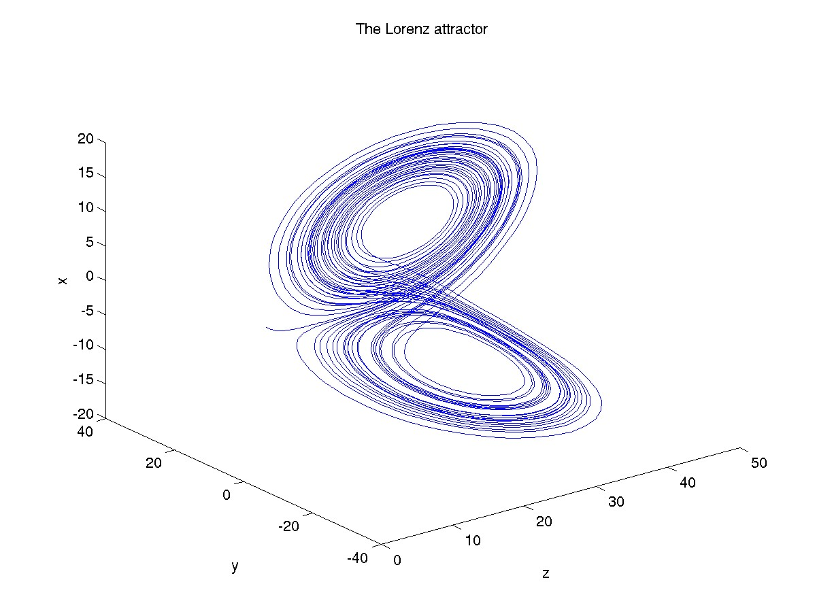
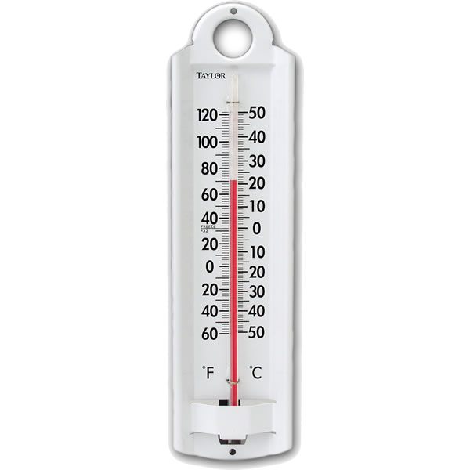
Lorenz 63 Model
Observing System 1
3 Instruments.
Each has own correlated error.

Slide 29
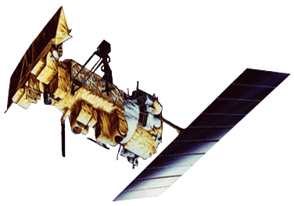
Lorenz 63 Model
Observing System 2
1 Instrument measures x,y,z each time.

Slide 30
L63 Results, Linked Difference Obs
3 Instruments
5 ensemble members.
Adaptive inflation.
Observations every 6 model timesteps.

Slide 31
L63 Results, Linked Difference Obs
3 Instruments
1 Instrument
5 ensemble members.
Adaptive inflation.
Observations every 6 model timesteps.

Slide 32
L63 Summary
Difference obs better unless uncorrelated error variance dominates.
Improvement greater for single instrument.
Ensembles often under-dispersive (what a surprise!).

Slide 33
Lorenz 96 Model, 40-variables
Observing System 1
40 Instruments.
Each has own correlated error.

Slide 34
Lorenz 96 Model, 40-variables
Observing System 2
1 instrument measures all 40 variables each time.

Slide 35
L96 Results, Linked Difference Obs
40 Instruments
10 ensemble members.
Adaptive inflation, 0.2 halfwidth localization.
Observations every model timestep.

Slide 36
L96 Results, Linked Difference Obs
40 Instruments
1 Instrument
10 ensemble members.
Adaptive inflation, 0.2 halfwidth localization.
Observations every model timestep.

Slide 37
L96 Results, Linked Difference Obs
Difference obs better unless uncorrelated error variance dominates.
Improvement much greater for single instrument.
Ensembles often over-dispersive.
Dealing with time correlation harder than space correlation.

Slide 38
Low-Order Dry Dynamical Core
Evolution of surface pressure field every 12 hours.
Has baroclinic instability: storms move east in midlatitudes.
Notes:
Slide 7: GPS occultation forward operators
Non-local refractivity : (Sokolovskiy et al., MWR 133, 2200-2212)
NEED DETAILS OF ALGORITHM step size???
upper limits
grid pictures for different latitudes
Three pictures exist: ~jla/talks_and_meetings/2009/ams/cam_gps_talk/gps_lat*
Expect minor differences with coarse grid, larger near poles

Slide 39
Low-Order Dry Dynamical Core
Evolution of surface pressure field every 12 hours.
Has baroclinic instability: storms move east in midlatitudes.
Notes:
Slide 7: GPS occultation forward operators
Non-local refractivity : (Sokolovskiy et al., MWR 133, 2200-2212)
NEED DETAILS OF ALGORITHM step size???
upper limits
grid pictures for different latitudes
Three pictures exist: ~jla/talks_and_meetings/2009/ams/cam_gps_talk/gps_lat*
Expect minor differences with coarse grid, larger near poles

Slide 40
Low-Order Dry Dynamical Core
Evolution of surface pressure field every 12 hours.
Has baroclinic instability: storms move east in midlatitudes.
Notes:
Slide 7: GPS occultation forward operators
Non-local refractivity : (Sokolovskiy et al., MWR 133, 2200-2212)
NEED DETAILS OF ALGORITHM step size???
upper limits
grid pictures for different latitudes
Three pictures exist: ~jla/talks_and_meetings/2009/ams/cam_gps_talk/gps_lat*
Expect minor differences with coarse grid, larger near poles

Slide 41
Low-Order Dry Dynamical Core
Evolution of surface pressure field every 12 hours.
Has baroclinic instability: storms move east in midlatitudes.
Notes:
Slide 7: GPS occultation forward operators
Non-local refractivity : (Sokolovskiy et al., MWR 133, 2200-2212)
NEED DETAILS OF ALGORITHM step size???
upper limits
grid pictures for different latitudes
Three pictures exist: ~jla/talks_and_meetings/2009/ams/cam_gps_talk/gps_lat*
Expect minor differences with coarse grid, larger near poles

Slide 42
Low-Order Dry Dynamical Core
Evolution of surface pressure field every 12 hours.
Has baroclinic instability: storms move east in midlatitudes.
Notes:
Slide 7: GPS occultation forward operators
Non-local refractivity : (Sokolovskiy et al., MWR 133, 2200-2212)
NEED DETAILS OF ALGORITHM step size???
upper limits
grid pictures for different latitudes
Three pictures exist: ~jla/talks_and_meetings/2009/ams/cam_gps_talk/gps_lat*
Expect minor differences with coarse grid, larger near poles

Slide 43
Low-Order Dry Dynamical Core
Evolution of surface pressure field every 12 hours.
Has baroclinic instability: storms move east in midlatitudes.
Notes:
Slide 7: GPS occultation forward operators
Non-local refractivity : (Sokolovskiy et al., MWR 133, 2200-2212)
NEED DETAILS OF ALGORITHM step size???
upper limits
grid pictures for different latitudes
Three pictures exist: ~jla/talks_and_meetings/2009/ams/cam_gps_talk/gps_lat*
Expect minor differences with coarse grid, larger near poles

Slide 44
Low-Order Dry Dynamical Core
Evolution of surface pressure field every 12 hours.
Has baroclinic instability: storms move east in midlatitudes.
Notes:
Slide 7: GPS occultation forward operators
Non-local refractivity : (Sokolovskiy et al., MWR 133, 2200-2212)
NEED DETAILS OF ALGORITHM step size???
upper limits
grid pictures for different latitudes
Three pictures exist: ~jla/talks_and_meetings/2009/ams/cam_gps_talk/gps_lat*
Expect minor differences with coarse grid, larger near poles

Slide 45
Low-Order Dry Dynamical Core
Evolution of surface pressure field every 12 hours.
Has baroclinic instability: storms move east in midlatitudes.
Notes:
Slide 7: GPS occultation forward operators
Non-local refractivity : (Sokolovskiy et al., MWR 133, 2200-2212)
NEED DETAILS OF ALGORITHM step size???
upper limits
grid pictures for different latitudes
Three pictures exist: ~jla/talks_and_meetings/2009/ams/cam_gps_talk/gps_lat*
Expect minor differences with coarse grid, larger near poles

Slide 46
Low-Order Dry Dynamical Core
Evolution of surface pressure field every 12 hours.
Has baroclinic instability: storms move east in midlatitudes.
Notes:
Slide 7: GPS occultation forward operators
Non-local refractivity : (Sokolovskiy et al., MWR 133, 2200-2212)
NEED DETAILS OF ALGORITHM step size???
upper limits
grid pictures for different latitudes
Three pictures exist: ~jla/talks_and_meetings/2009/ams/cam_gps_talk/gps_lat*
Expect minor differences with coarse grid, larger near poles

Slide 47
Low-Order Dry Dynamical Core
Evolution of surface pressure field every 12 hours.
Has baroclinic instability: storms move east in midlatitudes.
Notes:
Slide 7: GPS occultation forward operators
Non-local refractivity : (Sokolovskiy et al., MWR 133, 2200-2212)
NEED DETAILS OF ALGORITHM step size???
upper limits
grid pictures for different latitudes
Three pictures exist: ~jla/talks_and_meetings/2009/ams/cam_gps_talk/gps_lat*
Expect minor differences with coarse grid, larger near poles

Slide 48
Low-Order Dry Dynamical Core: Grid
30x60 horizontal grid, 5 levels.
Surface pressure, temperature, wind components.
28,800 variables.
Notes:
Slide 7: GPS occultation forward operators
Non-local refractivity : (Sokolovskiy et al., MWR 133, 2200-2212)
NEED DETAILS OF ALGORITHM step size???
upper limits
grid pictures for different latitudes
Three pictures exist: ~jla/talks_and_meetings/2009/ams/cam_gps_talk/gps_lat*
Expect minor differences with coarse grid, larger near poles

Slide 49
Low-Order Dry Dynamical Core: Observations
Assimilate once per day. 0.2 radian localization.
Observe each surface pressure grid point.
Uncorrelated obs error variance 100 Pa.
Notes:
Slide 7: GPS occultation forward operators
Non-local refractivity : (Sokolovskiy et al., MWR 133, 2200-2212)
NEED DETAILS OF ALGORITHM step size???
upper limits
grid pictures for different latitudes
Three pictures exist: ~jla/talks_and_meetings/2009/ams/cam_gps_talk/gps_lat*
Expect minor differences with coarse grid, larger near poles

Slide 50
Low-Order Dry Dynamical Core: Observations
Uncorrelated obs error variance 100 Pa.
Correlated obs error along ‘simulated polar orbiter track’.
Vary ratio of correlated to uncorrelated obs error variance.
Notes:
Slide 7: GPS occultation forward operators
Non-local refractivity : (Sokolovskiy et al., MWR 133, 2200-2212)
NEED DETAILS OF ALGORITHM step size???
upper limits
grid pictures for different latitudes
Three pictures exist: ~jla/talks_and_meetings/2009/ams/cam_gps_talk/gps_lat*
Expect minor differences with coarse grid, larger near poles

Slide 51
Low-Order Dry Dynamical Core: PS Results
Linked difference better for large correlated error.
Standard better for small correlated error.
Notes:
Slide 7: GPS occultation forward operators
Non-local refractivity : (Sokolovskiy et al., MWR 133, 2200-2212)
NEED DETAILS OF ALGORITHM step size???
upper limits
grid pictures for different latitudes
Three pictures exist: ~jla/talks_and_meetings/2009/ams/cam_gps_talk/gps_lat*
Expect minor differences with coarse grid, larger near poles

Slide 52
Low-Order Dry Dynamical Core: T Results
Linked difference better for large correlated error.
Standard better for small correlated error.
Notes:
Slide 7: GPS occultation forward operators
Non-local refractivity : (Sokolovskiy et al., MWR 133, 2200-2212)
NEED DETAILS OF ALGORITHM step size???
upper limits
grid pictures for different latitudes
Three pictures exist: ~jla/talks_and_meetings/2009/ams/cam_gps_talk/gps_lat*
Expect minor differences with coarse grid, larger near poles

Slide 53
PS RMSE Structure: Large Uncorrelated Error, Ratio 4
Base errors largest in storm tracks.
Linked difference errors largest in broad tropical band.
Notes:
Slide 7: GPS occultation forward operators
Non-local refractivity : (Sokolovskiy et al., MWR 133, 2200-2212)
NEED DETAILS OF ALGORITHM step size???
upper limits
grid pictures for different latitudes
Three pictures exist: ~jla/talks_and_meetings/2009/ams/cam_gps_talk/gps_lat*
Expect minor differences with coarse grid, larger near poles

Slide 54
PS RMSE Structure: Moderate Uncorrelated Error, Ratio 1
Base errors largest in storm tracks.
Linked difference errors largest in broad tropical band.
Notes:
Slide 7: GPS occultation forward operators
Non-local refractivity : (Sokolovskiy et al., MWR 133, 2200-2212)
NEED DETAILS OF ALGORITHM step size???
upper limits
grid pictures for different latitudes
Three pictures exist: ~jla/talks_and_meetings/2009/ams/cam_gps_talk/gps_lat*
Expect minor differences with coarse grid, larger near poles

Slide 55
PS RMSE Structure: Small Uncorrelated Error, Ratio 1/4
Base errors largest in storm tracks.
Linked difference errors largest in broad tropical band.
Notes:
Slide 7: GPS occultation forward operators
Non-local refractivity : (Sokolovskiy et al., MWR 133, 2200-2212)
NEED DETAILS OF ALGORITHM step size???
upper limits
grid pictures for different latitudes
Three pictures exist: ~jla/talks_and_meetings/2009/ams/cam_gps_talk/gps_lat*
Expect minor differences with coarse grid, larger near poles

Slide 56
T RMSE Structure: Small Uncorrelated Error, Ratio 1/4
Base errors largest in tropics.
Linked difference errors have similar pattern.
Notes:
Slide 7: GPS occultation forward operators
Non-local refractivity : (Sokolovskiy et al., MWR 133, 2200-2212)
NEED DETAILS OF ALGORITHM step size???
upper limits
grid pictures for different latitudes
Three pictures exist: ~jla/talks_and_meetings/2009/ams/cam_gps_talk/gps_lat*
Expect minor differences with coarse grid, larger near poles

Slide 57
Low-Order Dry Dynamical Core Summary
Linked difference obs better for large correlated error.
Linked difference not sensitive to correlated error size.
Adaptive inflation struggles with large correlated error.
Could use base approach for uncorrelated obs,
difference for correlated error obs.
For example, base for sondes, difference for radiances.
Difference obs allows assimilating before knowing correlated error characteristics.
Notes:
Slide 7: GPS occultation forward operators
Non-local refractivity : (Sokolovskiy et al., MWR 133, 2200-2212)
NEED DETAILS OF ALGORITHM step size???
upper limits
grid pictures for different latitudes
Three pictures exist: ~jla/talks_and_meetings/2009/ams/cam_gps_talk/gps_lat*
Expect minor differences with coarse grid, larger near poles

Slide 58
Outline
Dealing with correlated observation error in ensemble filters.
Idealized correlated error.
Difference observations.
Explictly modeling instrument error.
Comparing the two methods.
Conclusions and recommendations.

Slide 59
Modeling Correlated Observation Error
Error in examples is AR1:
(other types may need other methods).
Given correlated error now, can predict it at later time.
Have ensemble of model state.
Also ensemble of correlated error for each instrument.

Slide 60
Modeling Correlated Observation Error
1. Forecast: Advance model & correlated error ensembles.
2. Forward operator (for each ensemble member):
Apply standard forward operator to state, H(x),
Add correlated error.
3. Observation Increments: Compute normally.
4. State variable update:
Use regression (ensemble Kalman gain) to update:
Model state variables,
Correlated observation variables.

Slide 61
1D Exponential Growth Model Results
320 Member deterministic ensemble filter (EAKF) State

Slide 62
1D Exponential Growth Model Results
320 Member deterministic ensemble filter (EAKF) State
All results for 5000 steps after 1000 step spin-up.

Slide 63
1D Exponential Growth Model Results
320 Member deterministic ensemble filter (EAKF) State
10 trials shown by *.
Trial mean is line.
All results for 5000 steps after 1000 step spin-up.

Slide 64
1D Exponential Growth Model Results
320 Member deterministic ensemble filter (EAKF) State
Exact asymptotic solution can be computed.
Indistinguishable from 320 member ensemble.

Slide 65
1D Exponential Growth Model Results
320 Member deterministic ensemble filter (EAKF) Obs. Error
Exact asymptotic solution can be computed.
Indistinguishable from 320 member ensemble.

Slide 66
1D Exponential Growth Model Results
Fails for small ensembles with large correlated error.
320 Member EAKF
20 Member EAKF

Slide 67
1D Exponential Growth Model Results
Fails for small ensembles with large correlated error.
10 Member EAKF
20 Member EAKF

Slide 68
Ensemble Filters Scale Poorly for Random Fields
Ensemble size > 1 is exact with no correlated obs error.
Random walk evolution of correlated error is a problem.
Can reduce this by reducing ‘randomness’ of ensemble.
AR1 series for observation error is:
Given a posterior ensemble estimate of e at previous time:
Expected prior mean at next time is:
Expected prior variance is:
‘Deterministic’ forecast for observation error:
‘Adjust’ ensemble to have exactly these statistics.

Slide 69
1D Exponential Growth Model Results
Deterministic works with smaller ensembles. Used hereafter.
Nondeterm 20 Member
Determ 10 Member
Nondeterm 10 Member
Determ 5 Member

Slide 70
1D Exponential Growth Model Results
Try multiplicative inflation of state.
10 Member inflated
Optimal inflation gets large.
Multiplicative inflation for obs error ensemble is bad.

Slide 71
1D Exponential Growth Model Results
Multiplicative inflation for state improves performance.
10 Member
10 Member inflated

Slide 72
Lorenz 96 Model, 40-variables
Observing System 1:
40 Instruments.
Each has own correlated error.

Slide 73
Lorenz 96 Model, 40-instruments
20 member EAKF.
Optimal inflation.
Localization halfwidth 0.2
Modeling obs error helps.
Spread is deficient.

Slide 74
Lorenz 96 Model, 40-variables
Observing System 2:
1 instrument measures all 40 variables each time.

Slide 75
Lorenz 96 Model, 1-instrument
20 member EAKF.
Optimal inflation.
Localization halfwidth 0.2
Modeling obs error helps.
Spread is better than many instrument case.

Slide 76
Outline
Dealing with correlated observation error in ensemble filters.
Idealized correlated error.
Difference observations.
Explictly modeling instrument error.
Comparing the two methods.
Conclusions and recommendations.

Slide 77
Lorenz 96 Model, 40-instruments
Time difference assimilation best for large correlated error.
Terrible for small correlated error.
20 member EAKF.
Optimal inflation.
Localization halfwidth 0.2

Slide 78
Lorenz 96 Model, 1-instrument
Time difference assimilation best for large correlated error.
Not bad for small correlated error.
20 member EAKF.
Optimal inflation.
Localization halfwidth 0.2

Slide 79
Outline
Dealing with correlated observation error in ensemble filters.
Idealized correlated error.
Difference observations.
Explictly modeling instrument error.
Comparing the two methods.
Conclusions and recommendations.

Slide 80
Conclusions
Modeling correlated obs error ‘optimal’ for large ensemble.
Sampling error is a problem for small ensembles.
Multiplicative state inflation can reduce this problem.
Additive inflation for obs error may help?
Time difference obs effective for large correlated error.
General things to keep in mind:
Details of filtering problem determine best methods.
Making models/filters more deterministic generally helps.

Slide 81
Learn more about DART at:
www.image.ucar.edu/DAReS/DART
Anderson, J., Hoar, T., Raeder, K., Liu, H., Collins, N., Torn, R., Arellano, A., 2009: The Data Assimilation Research Testbed: A community facility.
BAMS, 90, 1283—1296, doi: 10.1175/2009BAMS2618.1

